Slide 1
Good UX Design Session #06
Course : GAME6012/ User Experiences
Effective Period : September 2017

Slide 2
Learning Objectives

Slide 3
Good UX Design
Design is what we deliver at the end of the day after all of the research, brainstorming, team meetings, requirements, solutions, wireframing, prototyping, usability testing, and iterating has been done. However, how do we know whether what we've delivered is good? From an aesthetic perspective, it's difficult to say what good design is, because good design is not easily identifiable.
In fact, it is quite hard to identify because it is often very subjective. For example, one person may love an iPhone while another swears that an Android phone is better. This used to happen with Macs and PCs too, but Apple makes a better machine and the competition simply can't compete. Then again, you might disagree.

Slide 4
What is good design?
For a designer of any kind, subjectivity is one of the hardest things to overcome when designing for other people. It is much easier to design what we want than to ask our customers/users what they want. When a design is subjective, it is often based on nothing more than our opinion, and we can easily mistake our opinion for that of our customers/users. When this happens, problems can occur.
What if GoJek creator the an ojek driver?

Slide 5
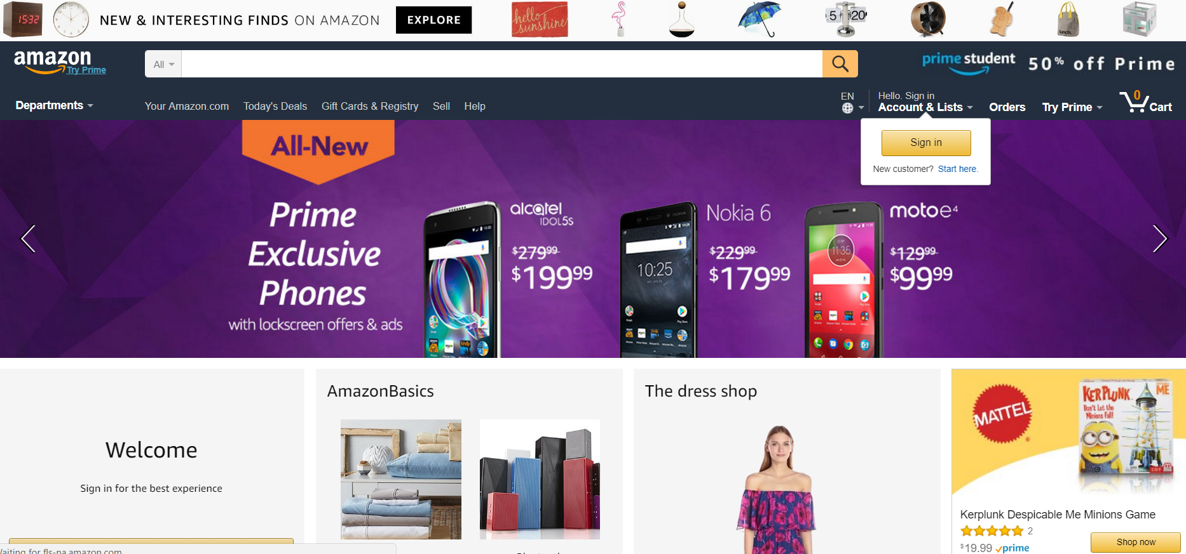
Good design is non-obvious
Amazon 2001

Slide 6
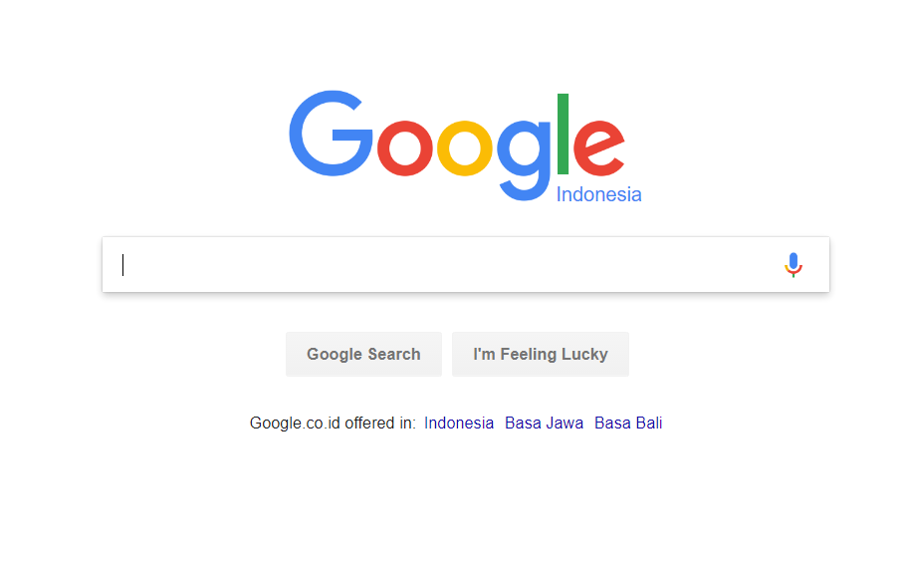
Good design is non-obvious

Slide 7
Good design is familiar

Slide 8
(Sometime) preference beats performance

Slide 9
Principles of good UX design,
Innovative
iPod presented a unique design of unmatched simplicity. Any of the annoyances were minor compared to the payoff, which was ease of use, the cool factor, portability, and a lot of music in your pocket. To get going, all you needed were some songs in the MP3 format and headphones. No directions/instructions needed. Now, of course, Apple could have turned this device into something more than just a music player.They could have included a radio, a to-do list application, or features similar to a palm pilot (remember those?). But they didn't. Why? Because Apple stayed focused on the problem at hand. With the introduction and popularity of digital music and Apple's previous innovation with iTunes, taking music with you was the next logical step. Sure, there were other devices out there, but none did it as well as Apple.

Slide 10
Principles of good UX design,
Is not always original

Slide 11
Principles of good UX design,
Useful

Slide 12
Principles of good UX design,
Understandable

Slide 13
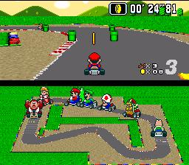
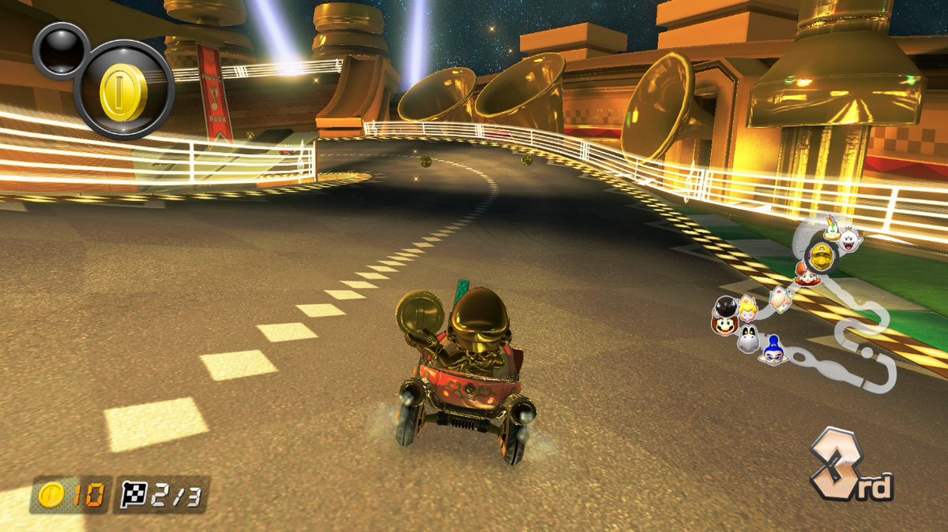
In game?
What changes?

Slide 14
Assignment
Search a game franchise
Compare the user experience of both game using emulator
See what improved or what is lacking

Slide 15
References
Buxton, William. 2007. Sketching user experience. Elsevier
Anderson, Stephen. 2011. Seductive Interaction Design. New Riders.
Faranello, Scott. 2016. Practical UX Design. Packt Publishing

